Slide 1
Data Analytics (CMP330)
Dr. David Glass
School of Computing
dh.glass@ulster.ac.uk
Week 5 – Introduction to Inferential Statistics and Hypothesis Testing with R
ulster.ac.uk

Slide 2
Week 5
Content
Inferential Statistics
Random Sampling
Sampling Error
Confidence Intervals
T - Distributions
Hypothesis Testing
Z-test & t-test
A range of t tests
Chi-square test
F-test

Slide 3
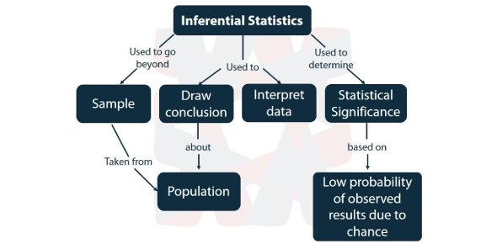
Inferential statistics
https://www.proprofs.com/quiz-school/story.php?title=all-about-inferential-statistical-tests

Slide 4
Inferential statistics
Standard analysis tools of inferential statistics
Confidence intervals
Hypothesis tests
Regression analysis

Slide 5
Random Sampling
Importance of randomisation
Avoiding bias and confounders
Random
sampling
Inference
Sample
statistics
Population
statistics
Sample
Population

Slide 6
Random Sampling
Sampling methods
Importance of representation
Simple random sampling
Systematic sampling
Stratified sampling
Cluster sampling
Stage sampling
Convenience sampling

Slide 7
Random Sampling
Data Provenance
“Provenance (from the French provenir, 'to come from/forth') is the chronology of the ownership, custody or location of a historical object.” wikipedia
Data provenance is the history of a dataset
Data cleaning processes
Imputations for missing data
How it was collected and by whom
Access to previous versions etc.

Slide 8
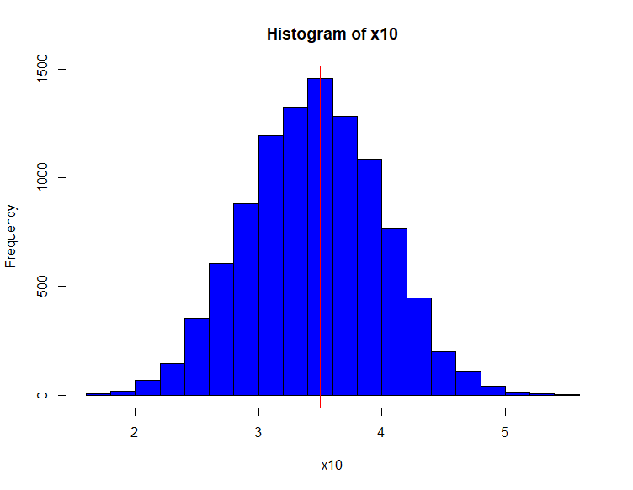
Random Sampling
Sampling error
“sampling error is the error caused by observing a sample instead of the whole population” – Wikipedia
Sampling distribution of the mean
Example. Take multiple random samples and find the mean for each sample, e.g. the mean value obtained from 10 rolls of a die.
When this is repeated enough times we get a normal distribution according to the Central limit theorem (see week 4)

Slide 9
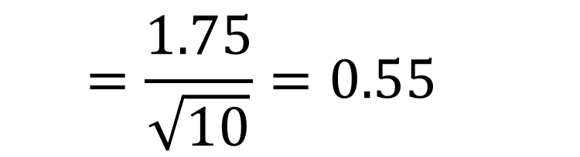
Sampling Error
Standard Error of the Mean
How far do we expect the sample mean to be from the population mean?
E.g. Sample mean = 3.2 (from 10 rolls of the die)
s = 1.75
n = 10
s = standard deviation
n = number of sampling units
$$=\frac{1.75}{\sqrt{10}}=0.55$$

Slide 10
Sampling Error
Standard Error of the Mean
The greater sample size the greater the reliability of the statistic
10
Standard error of the mean
0
1
Sample size
25

Slide 11
Confidence intervals
68.26% confident of population mean being 3.20 ± 0.55
95% confident of mean being 3.20 ± (1.96*0.55=1.08)
Between 2.12 and 4.28
3.20 (95% CI: 2.12, 4.28)
Margin of error = 1.08
NOTE:
Simply treat SE as 1 standard deviation

Slide 12
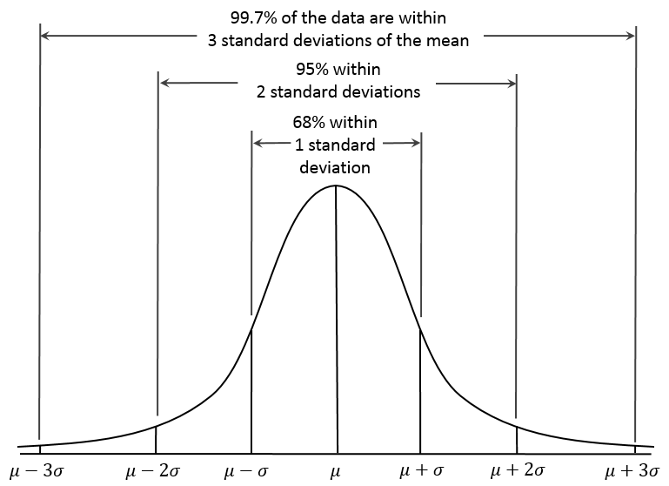
Confidence intervals
This all assumes that the variable is normally distributed
If its not normal, then 1.96 could mean something different
1.96
1.96
https://commons.wikimedia.org/wiki/File:Empirical_Rule.PNG

Slide 13
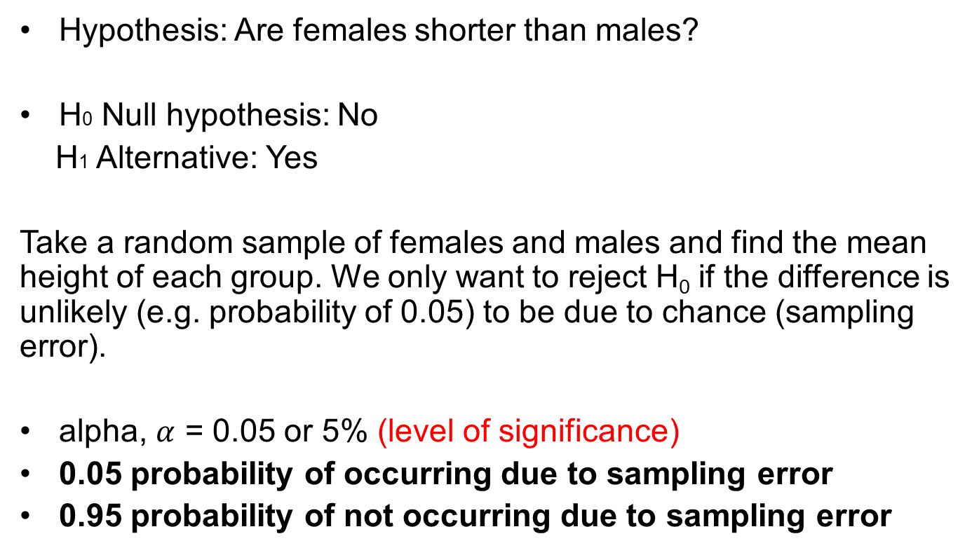
Hypothesis testing
Hypothesis: Are females shorter than males?
H0 Null hypothesis: No
H1 Alternative: Yes
Take a random sample of females and males and find the mean height of each group. We only want to reject H₀ if the difference is unlikely (e.g. probability of 0.05) to be due to chance (sampling error).
alpha, $α$ = 0.05 or 5% (level of significance)
0.05 probability of occurring due to sampling error
0.95 probability of not occurring due to sampling error

Slide 14
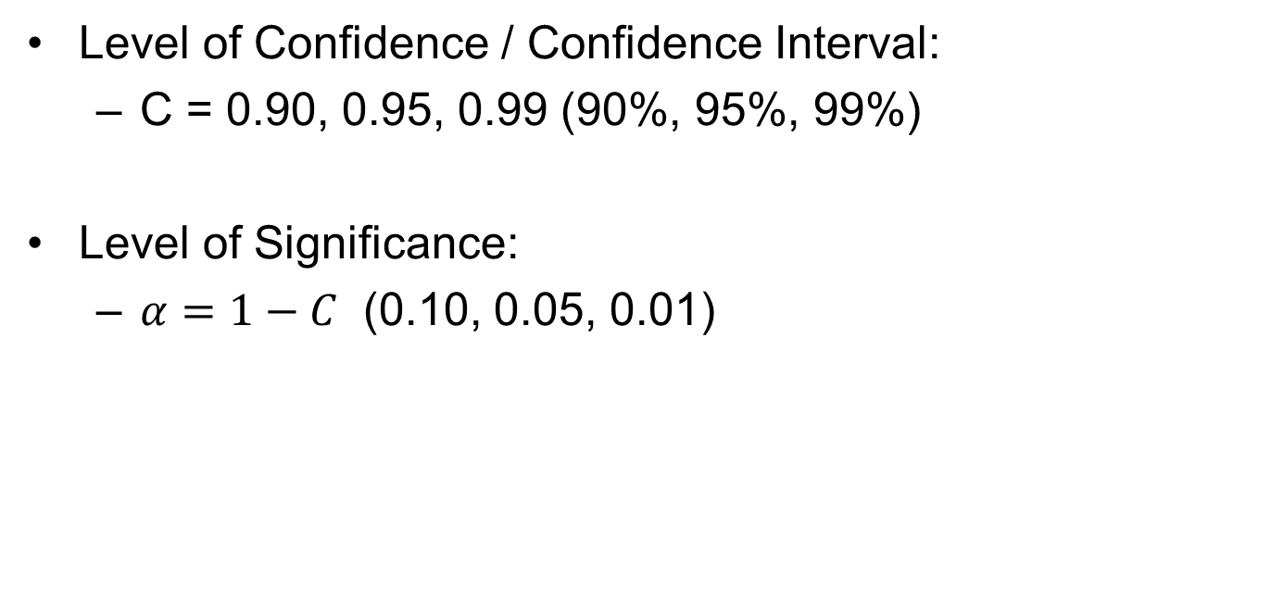
Confidence intervals & Significance Level
Level of Confidence / Confidence Interval:
C = 0.90, 0.95, 0.99 (90%, 95%, 99%)
Level of Significance:
$α=1−C$ (0.10, 0.05, 0.01)

Slide 15
P-Value
“In null hypothesis significance testing, the p-value is the probability of obtaining test results at least as extreme as the results actually observed, under the assumption that the null hypothesis is correct.” – Wikipedia
When the “P” is Low, the “H0” Must Go!

Slide 16
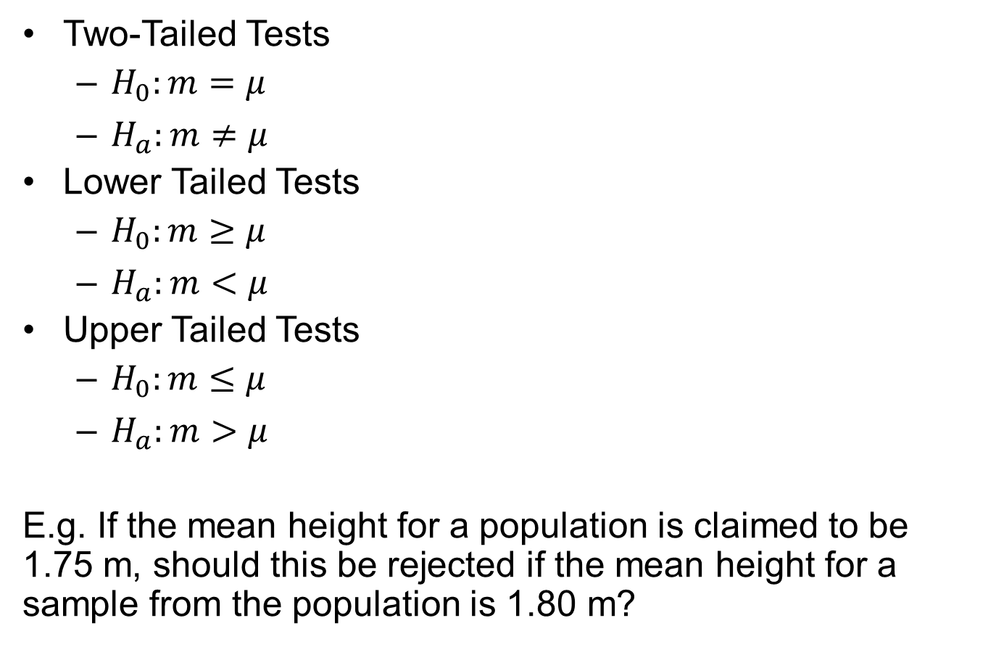
Hypothesis testing
Hypothesis test
Two-Tailed Tests
$H_{0}:m=μ$
$H_{a}:m≠μ$
Lower Tailed Tests
$H_{0}:m≥μ$
$H_{a}:m<μ$
Upper Tailed Tests
$H_{0}:m≤μ$
$H_{a}:m>μ$
E.g. If the mean height for a population is claimed to be 1.75 m, should this be rejected if the mean height for a sample from the population is 1.80 m?
m: sample mean
𝜇: hypothesised mean
One-Tailed tests

Slide 17
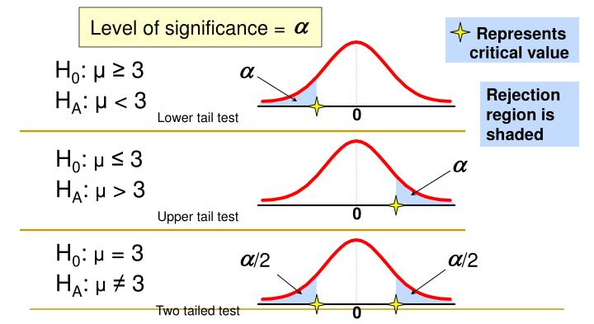
Hypothesis testing
Hypothesis test
https://www.slideserve.com/bowie/chapter-8-introduction-to-hypothesis-testing-1337430

Slide 18
Hypothesis testing
Procedure for hypothesis test
A random sample is drawn from a population
A null hypothesis is formulated
Select a probability of error level (alpha level). Generally, 0.05
A test-statistic is calculated, of which we know the probability distribution
p-value: evidence for a hypothesis- comparing the observed value of the statistic with the corresponding distribution
If the p-value<0.05, reject the null hypothesis

Slide 19
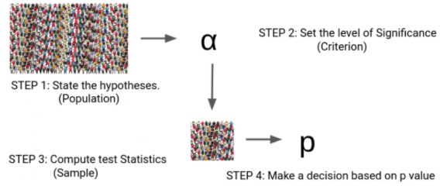
Hypothesis testing
Procedure for hypothesis test
https://www.analyticsvidhya.com/blog/2020/06/statistics-analytics-hypothesis-testing-z-test-t-test/

Slide 20
Hypothesis testing
Typical steps in hypothesis testing
Test assumptions of data
Normality, homoscedasticity (variance, SD)
Choose appropriate hypothesis/significance test:
Parametric test: Z-test, t-test
Non-parametric test: Mann-Whitney U Test

Slide 21
Hypothesis testing
Homoscedasticity
“if the ratio of the largest sample variance to the smallest sample variance does not exceed 1.5, the groups satisfy the requirement of homoscedasticity”
http://blog.minitab.com/blog/statistics-and-quality-data-analysis/dont-be-a-victim-of-statistical-hippopotomonstrosesquipedaliophobia

Slide 22
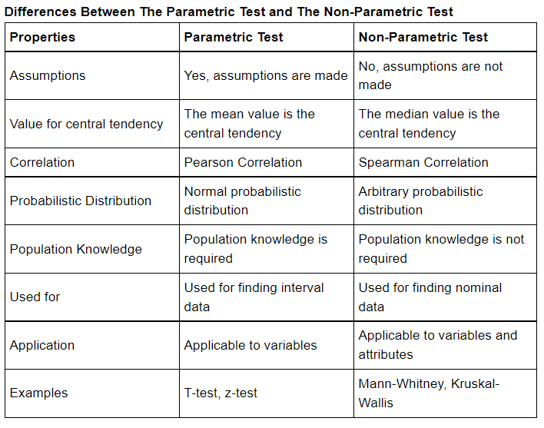
Hypothesis testing
Parametric test vs Non-parametric test
Parametric is a test in which parameters are assumed and the population distribution is always known
There is no requirement for any distribution of the population in the non-parametric test.
https://www.vedantu.com/maths/difference-between-parametric-and-non-parametric-test

Slide 23
Hypothesis testing
Normality Testing
Shapiro-Wilk test of normality.
shapiro.test()
Hypothesis test
H0 = Null hypothesis: Data is normally distributed
Ha = Alternative hypothesis: Data is not normally distributed

Slide 24
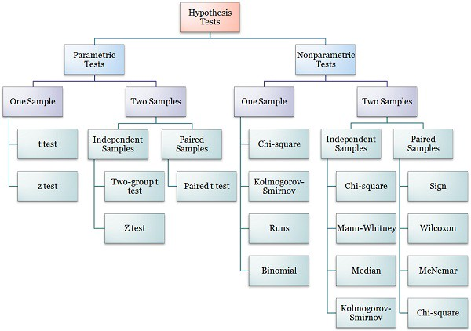
Hypothesis testing
https://medium.com/analytics-vidhya/statistical-hypothesis-tests-126cd39ee93b

Slide 25
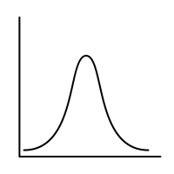
Hypothesis testing
One sample z test / z statistic (only use when n > 30)
Mean height of population (distribution using SE)
Probability of having this Z value or more extreme
mean
mean
From sample male group

Slide 26

Hypothesis testing
Calculate Test Statistic
Single sample
$$z=\frac{(x−μ)}{σ}$$
Mean of multiple samples
$$z=\frac{(\overline{x}−μ)}{(σ/{\sqrt{n}})}$$

Slide 27
Hypothesis testing
Calculate Test Statistic – Z Test
We perform the One-Sample Z test when we want to compare a sample mean with the population mean.
Example: It is claimed that the mean height of men of a given population is equal to 1.75m. We have the information that the standard deviation for men’s height is 0.23. We had collected the data of 36 men by using random samples and record their heights. The mean height from our samples is 1.80. Finally, we also set our α value (0.05). We will test whether the mean height of the population is greater than 1.75cm or not at a 5% level of significance.

Slide 28
Hypothesis testing
Calculate Test Statistic – Z Test
In this example:
Sample mean height for men is 1.80
The size of sample is 36
The population mean is claimed to be 1.75
The population standard deviation is 0.23

Slide 29
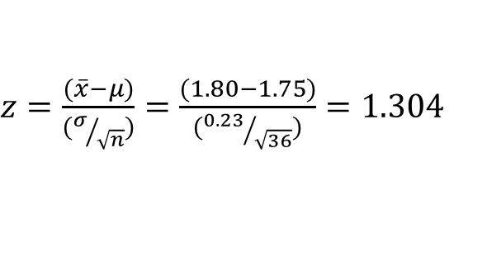
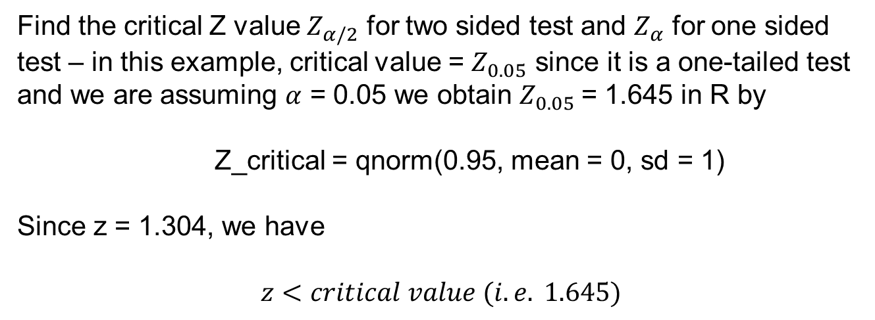

Hypothesis testing
Calculate Test Statistic – Z Test
$z=\frac{(\overline{x}−μ)}{(σ/{\sqrt{n}})}=$ $\frac{(1.80−1.75)}{({0.23}/{\sqrt{36}})}=1.304$
$H_{0}:m=1.75$
$$H_{a}:m>1.75$$
Find the critical Z value $Z_{α/2}$ for two sided test and $Z_{α}$ for one sided test – in this example, critical value = $Z_{0.05}$ since it is a one-tailed test and we are assuming $α$ = 0.05 we obtain $Z_{0.05}$= 1.645 in R by
Z_critical = qnorm(0.95, mean = 0, sd = 1)
Since z = 1.304, we have
$$z<critical value (i.e. 1.645)$$
Since the Z statistic is less than the critical value (1.645), we cannot reject the null hypothesis and so conclude that the average height of men is not greater than 1.75m.

Slide 30
T distribution
As sample sizes become smaller, the wider the distribution
T and Z distributions approximately equal when n ≥ 30.
http://www.dummies.com/education/math/statistics/how-to-tell-a-z-distribution-from-a-t-distribution/

Slide 31
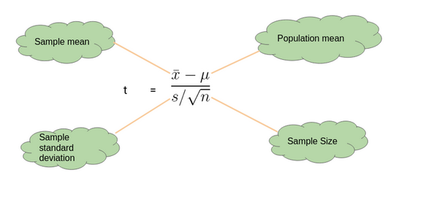
Hypothesis testing
Calculate Test Statistic – T Test
We perform a One-Sample t-test when we want to compare a sample mean with the population mean. We use the sample standard deviation instead of population standard deviation in this case.
Degrees of freedom: df=n−1
https://www.analyticsvidhya.com/blog/2020/06/statistics-analytics-hypothesis-testing-z-test-t-test/

Slide 32
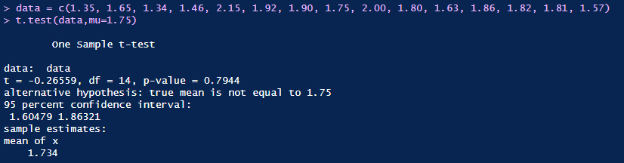
Hypothesis testing
One sample T test in R
Consider again the claim that the mean height of men of a given population is equal to 1.75 m and suppose we have a random sample as follows:
1.35 1.65 1.34 1.46 2.15 1.92 1.90 1.75 2.00 1.80 1.63 1.86 1.82 1.81 1.57
Since there are only 15 samples we need to use a T test. To carry this out in R:
Since the p-value is greater than 0.05, we cannot reject the null hypothesis and so we conclude based on our result that average height of our samples is not significantly different than 1.75 m.

Slide 33
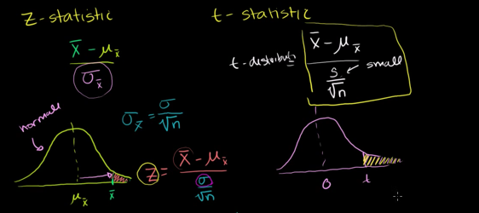
Exercise: Z tests vs T tests
https://www.youtube.com/watch?v=5ABpqVSx33I

Slide 34
Hypothesis testing
Z-test and T-test
Z-test: are a statistical way of testing a hypothesis when either:
We know the population variance, or
We do not know the population variance but our sample size is large n ≥ 30
T-test: are a statistical way of testing a hypothesis when:
We do not know the population variance
Our sample size is small, n < 30
https://www.analyticsvidhya.com/blog/2020/06/statistics-analytics-hypothesis-testing-z-test-t-test/

Slide 35
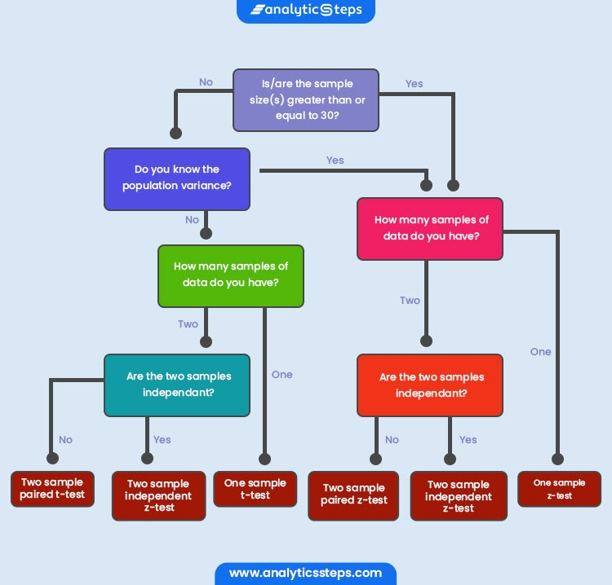
Hypothesis testing
Z-test vs T-test
https://www.analyticssteps.com/blogs/what-are-differences-between-z-test-and-t-test

Slide 36
Hypothesis testing
A range of t tests
One sample t test
Paired t-test (same group, e.g. mean pre and post measure)
Independent two-sample t-test
Equal sample sizes, equal variance
Unequal sample sizes, equal variance
Welch's t-test
One tail vs. two tails

Slide 37
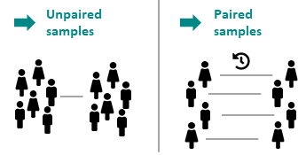
Hypothesis testing
Paired t-test vs unpaired t-test
The paired t test is used to determine whether the mean difference between two sets of observations is zero.
The unpaired two-samples t-test is used to compare the mean of two independent groups.
https://datatab.net/statistics-calculator/hypothesis-test/t-test

Slide 38

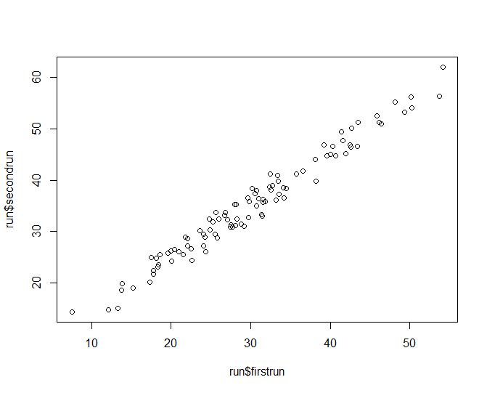
Hypothesis testing
Paired t-test exercise
Using run.csv

Slide 39
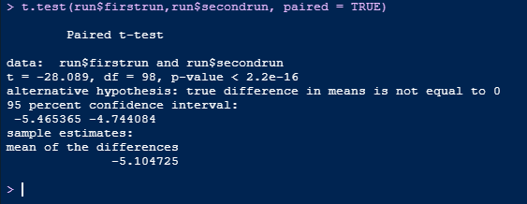
Hypothesis testing
Paired t-test exercise
Is there a statistical difference between how far people ran in the first and second run?
Paired t test (same group of people)

Slide 40
Hypothesis testing
Unpaired t-test exercise
Collect weights from 9 females
Collect weights from 9 males
# Data in two numeric vectors
women_weight <- c(38.9, 61.2, 73.3, 21.8, 63.4, 64.6, 48.4, 48.8, 48.5)
men_weight <- c(67.8, 60, 63.4, 76, 89.4, 73.3, 67.3, 61.3, 62.4)
# Create a data frame
my_data <- data.frame(
group = rep(c("Woman", "Man"), each = 9),
weight = c(women_weight, men_weight)
)
http://www.sthda.com/english/wiki/unpaired-two-samples-t-test-in-r

Slide 41
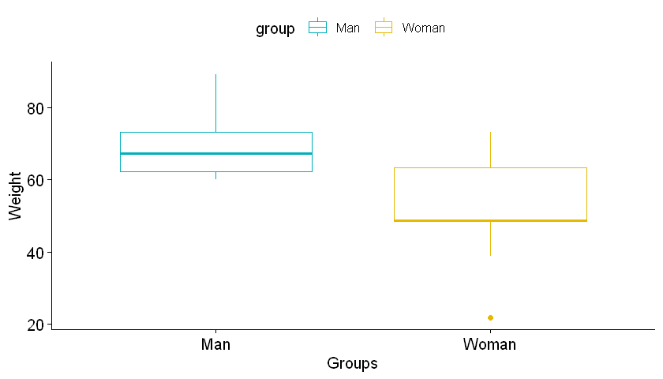
Hypothesis testing
Unpaired t-test exercise
Visualise data using box plot
# Plot weight by group and color by group
library("ggpubr")
ggboxplot(my_data, x = "group", y = "weight",
color = "group", palette = c("#00AFBB", "#E7B800"),
ylab = "Weight", xlab = "Groups")
http://www.sthda.com/english/wiki/unpaired-two-samples-t-test-in-r

Slide 42
Hypothesis testing
Unpaired t-test exercise
Assumption 1: Are the two samples independent?
Yes, samples are from men and women which are not related

Slide 43
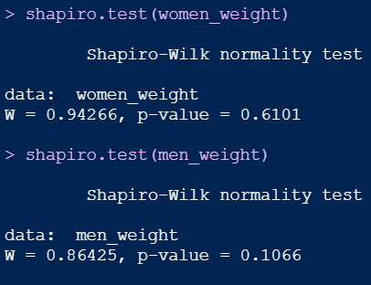
Hypothesis testing
Unpaired t-test exercise
Assumption 2: Are the data from each of the 2 groups follow a normal distribution?
shapiro.test()
p-value > 0.05 implying that the distribution of the differences are not significantly different from normal distribution. In other words, we can assume the normality.

Slide 44
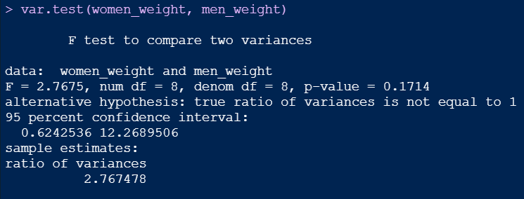
Hypothesis testing
Unpaired t-test exercise
Assumption 3. Do the two populations have the same variances?
F-test (var.test())
The p-value of F-test is p is greater than significance level 0.05. In conclusion, there is no significant difference between the two variances.

Slide 45
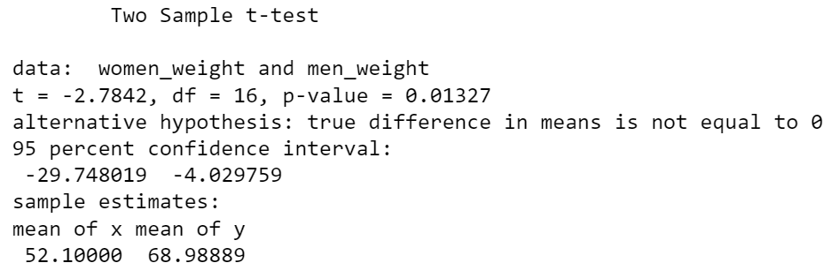
Hypothesis testing
Unpaired t-test exercise
t.test(women_weight, men_weight, var.equal = TRUE)
Conclude: There is a statistically significant difference (p<0.05) between the weights of males and females.

Slide 46
Hypothesis testing
Types of Errors
Type I errors
errors where the result is statistically significant despite the fact that the null hypothesis is true
a false positive
e.g. a diagnosis of cancer (“positive”) for healthy subject

Slide 47
Hypothesis testing
Types of Errors
Type II errors
errors where the result is NOT significant despite the fact that the null hypothesis is false
a false negative
e.g. a diagnosis of healthy for a subject who has cancer

Slide 48
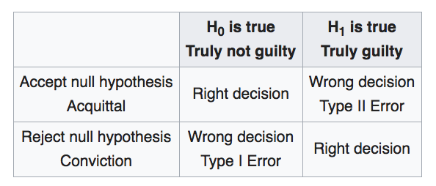
Hypothesis testing
Types of Errors
Analogous to a court room
(False Negative)
(False Positive)
“error of the first kind (i.e., the conviction of an innocent person)”
“error of the second kind (acquitting a person who committed the crime)”
https://en.wikipedia.org/wiki/Statistical_hypothesis_testing

Slide 49
Hypothesis testing
Statistical Power
Probability of achieving statistical significance when null hypothesis is false
power = 1 – β
Where β is the probability of a type 2 error
Power can be increased by:
Increasing sample size
Using a higher alpha value
Using a one-sided test

Slide 50
Hypothesis testing
Statistical Power is important
Prospectively (a priori)
Scientific - Collect the right amount of data
Ethical – no continuous unnecessary harm (e.g. in drug trials)
Retrospectively (post hoc):
Was there enough power in my test and sample size to get statistical significance, given the effect measured

Slide 51
Hypothesis testing
Tests for Variance
F-test
F-test is used to assess whether the variances of two populations (A and B) are equal.
Chi Square test
Chi Square test is to test whether there is a statistical significance between 2 proportions.

Slide 52

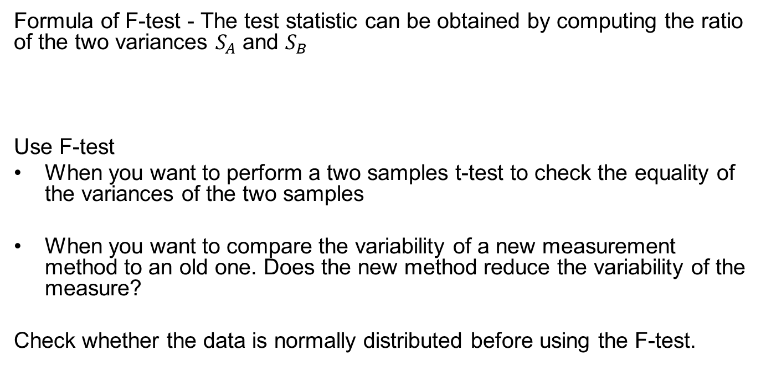
Hypothesis testing
F-test
Formula of F-test - The test statistic can be obtained by computing the ratio of the two variances $S_{A}$ and $S_{B}$
Use F-test
When you want to perform a two samples t-test to check the equality of the variances of the two samples
When you want to compare the variability of a new measurement method to an old one. Does the new method reduce the variability of the measure?
Check whether the data is normally distributed before using the F-test.
$$F=\frac{{S_{A}}^{2}}{{S_{B}}^{2}}$$
http://www.sthda.com/english/wiki/f-test-compare-two-variances-in-r

Slide 53
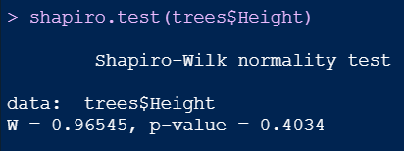
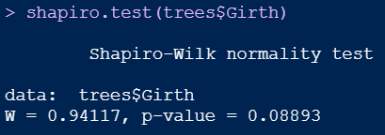
Hypothesis testing
F-test
Check whether the data is normally distributed before using the F-test.
Shapiro-Wilk test
shapiro.test()
Use Q-Q plot (quantile-quantile plot) to graphically evaluate the normality of a variable.
p-value > 0.05 implying that the distribution of the differences are not significantly different from normal distribution. In other words, we can assume the normality.

Slide 54
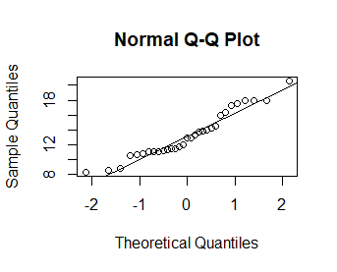

Hypothesis testing
Q-Q plot (quantile-quantile plot)
QQ plots are used to visually check the normality of the data.
The deviations from the straight line are minimal. This indicates normal distribution.
The R base functions qqnorm() and qqplot() can be used to produce quantile-quantile plots:
qqnorm(): produces a normal QQ plot of the variable
qqline(): adds a reference line

Slide 55
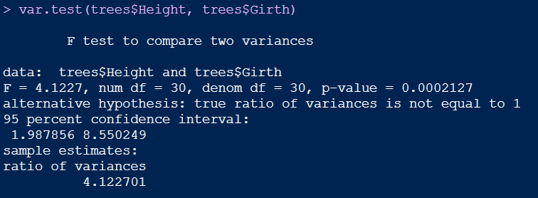
Hypothesis testing
Compute F-test in R
var.test(x, y, alternative = "two.sided")
The p-value of F-test is p is less than significance level 0.05. In conclusion, there is significant difference between the two variances.

Slide 56
Hypothesis testing
Chi-square test
Testing whether there is a statistical significance between 2 proportions:
E.g.
25/30 people said they really enjoyed course A
23/35 people said they really enjoyed course B
Is there a significant difference?

Slide 57
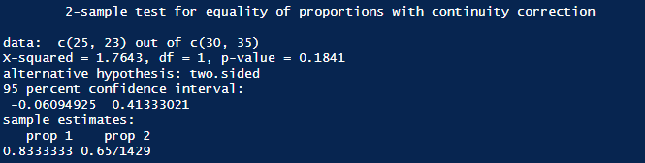
Hypothesis testing
Chi Square tests / tests comparing proportions in R
prop.test(x=c(25,23), n=c(30,35))

Slide 58

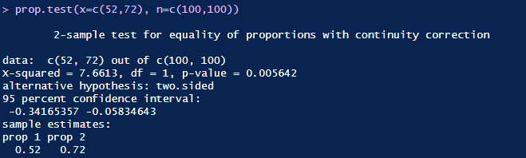
Hypothesis testing
Chi Square tests - A/B testing example
https://en.wikipedia.org/wiki/A/B_testing#/media/File:A-B_testing_example.png
The p-value of F-test is less than significance level 0.05. In conclusion, there is significant difference between the two designs.

Slide 59
Hypothesis testing
Chi-square test of independence
Chi-square test of independence tests whether there is a relationship between two categorical variables.
H0: the variables are independent, there is no relationship between the two categorical variables.
H1: the variables are dependent, there is a relationship between the two categorical variables.
Example using built-in data set survey from MASS package
Test the hypothesis whether smoking habit is independent of exercise level at 0.05 significance level.
https://statsandr.com/blog/chi-square-test-of-independence-in-r/

Slide 60
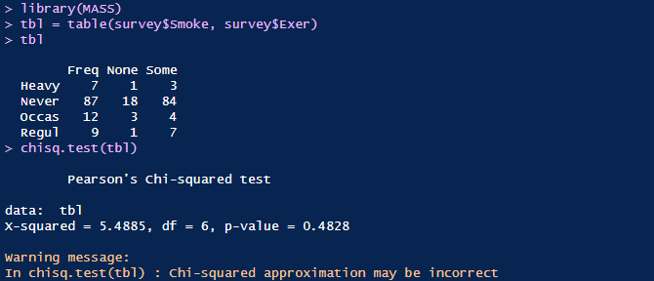
Hypothesis testing
Chi-square test of independence
As the p-value 0.4828 is greater than the .05 significance level, we do not reject the null hypothesis that smoking is independent of the exercise level of the students.
http://www.r-tutor.com/elementary-statistics/goodness-fit/chi-squared-test-independence

Slide 61
Hypothesis testing
Comparison of multiple groups
Analysis of Variance (ANOVA) – omnibus test
This test basically compares the means between many groups
Assumptions:
Normality
Equal variances
Independent samples for each group

Slide 62
Hypothesis testing
Exercise – video tutorial – hypothesis testing
https://www.khanacademy.org/math/statistics-probability/significance-tests-one-sample/tests-about-population-mean/v/hypothesis-testing-and-p-values

